Slide 1

Team Name : Mymtraminds
Team Details: Smita Singh Sneha Jaiswal Sunidhi Tomar

Slide 2

Project Overview And Goals
Project Overview
Demand forecasting: An estimate of sales during a specific future period .
Based on:Proposed marketing plan and uncontrollable and competitive forces.
Goals:
Accurate demand forecasting: Essential for business success.
Influence: Impacts various operational facets.
Predict future consumer preferences and market trends: Empowers informed decision-making
Optimize resource allocation: Ensures efficient use of resources.
Maintain a competitive edge: Keeps organizations ahead in the market.

Slide 3
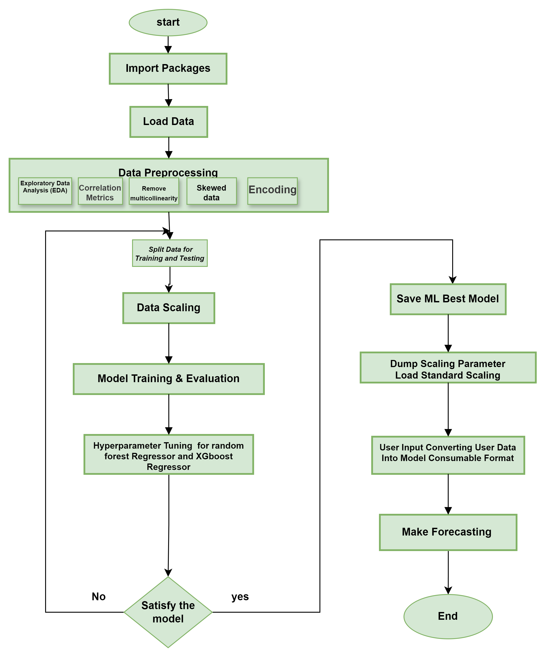
Strategic Approach and Workflow Diagram
Load essential libraries for data processing and model building.
Import dataset for analysis.
The data structure and content were analyzed to identify patterns and anomalies
The relationships between the features are calculated
Eliminate highly correlated features to improve the model accuracy.
Transform skewed data for normalization
Convert categorical data into a numerical format.
. The data were divided into training and testing sets.
Standardize data for consistent model performance.
Development of a predictive model using training data.
Assessment of model performance using evaluation metrics.
Different models are compared to identify the best performer.
Optimizing parameters for Random Forest and XGBoost models.
The most accurate model should be stored for future use.
Save scaling parameters for deployment consistency.
Apply saved scaling during the prediction.
Transform the user data for model compatibility.
The model was used to make real-time predictions based on user input.

Slide 4
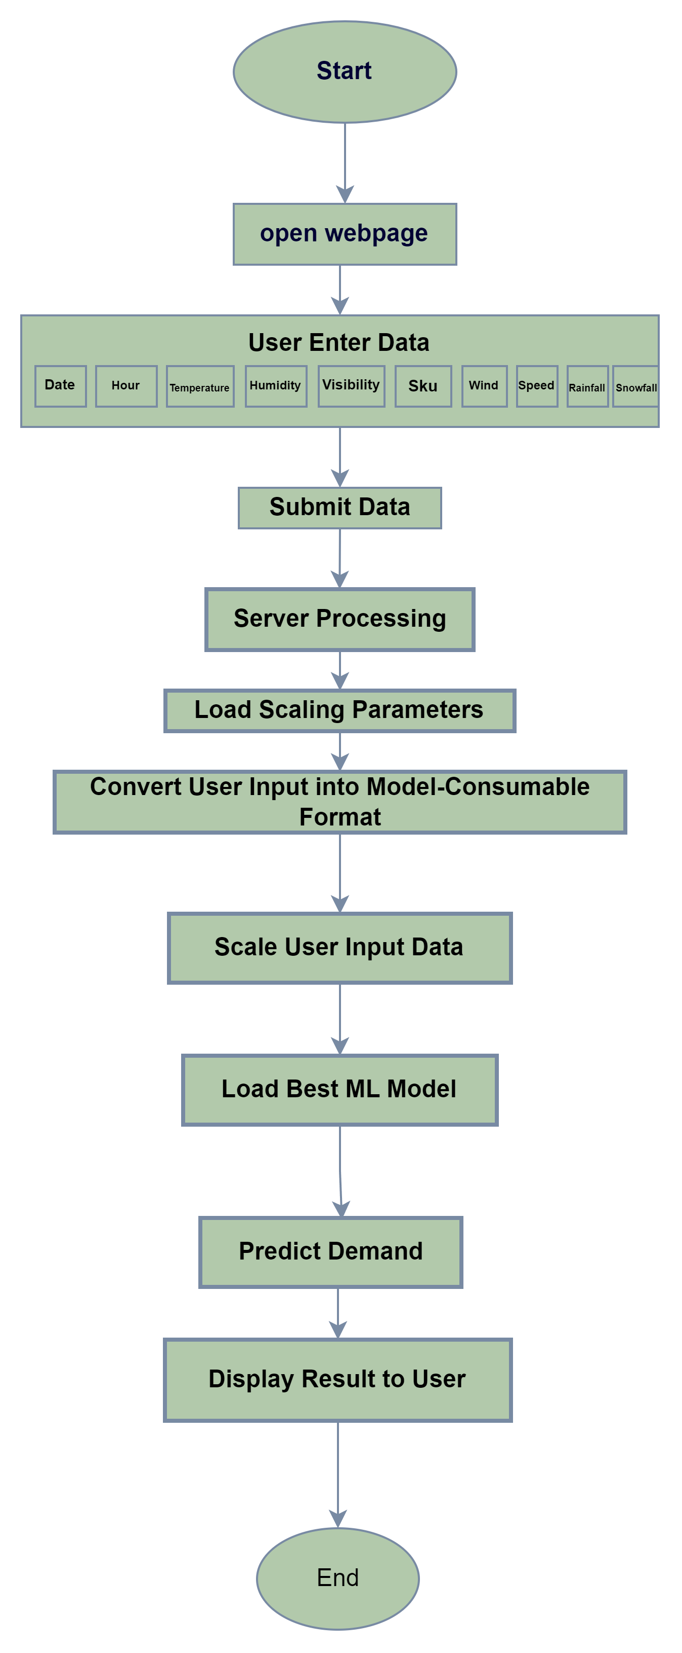
Strategic Approach and Workflow Diagram For Users
User accesses the web page.
Display interface for data entry.
Input sales, temperature, etc
Send data to the server.
Handle data preparation
Fetch normalization details.
Format data for model
Normalize input using fetched parameters.
Access trained predictive model
Compute forecast using model
Show predicted demand to

Slide 5
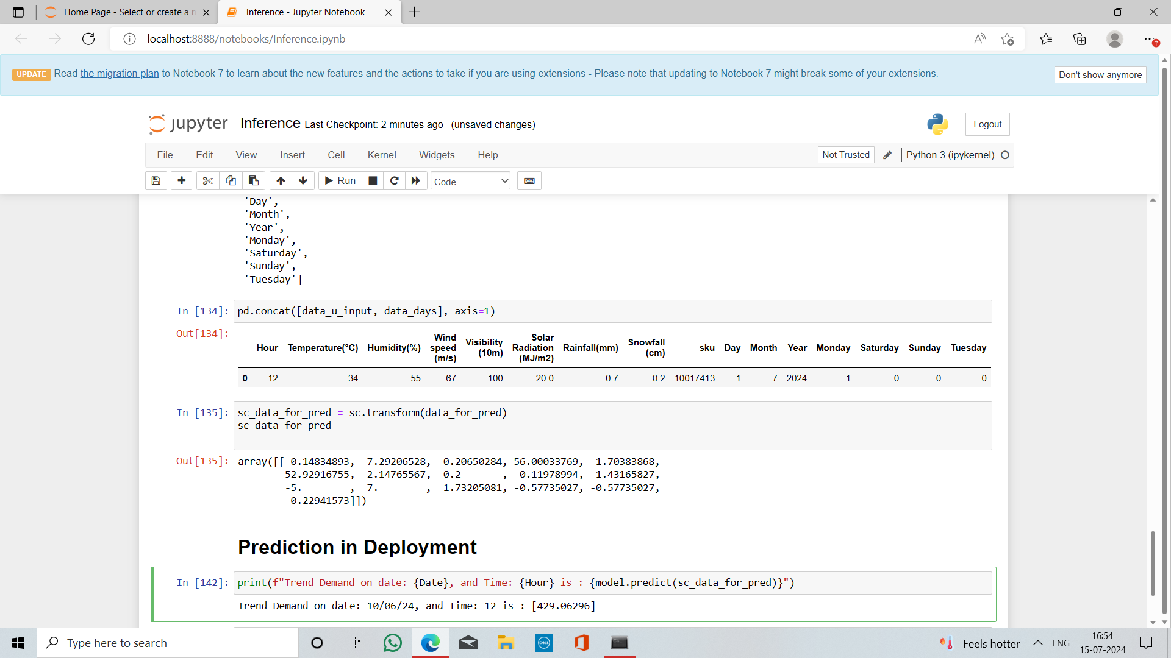
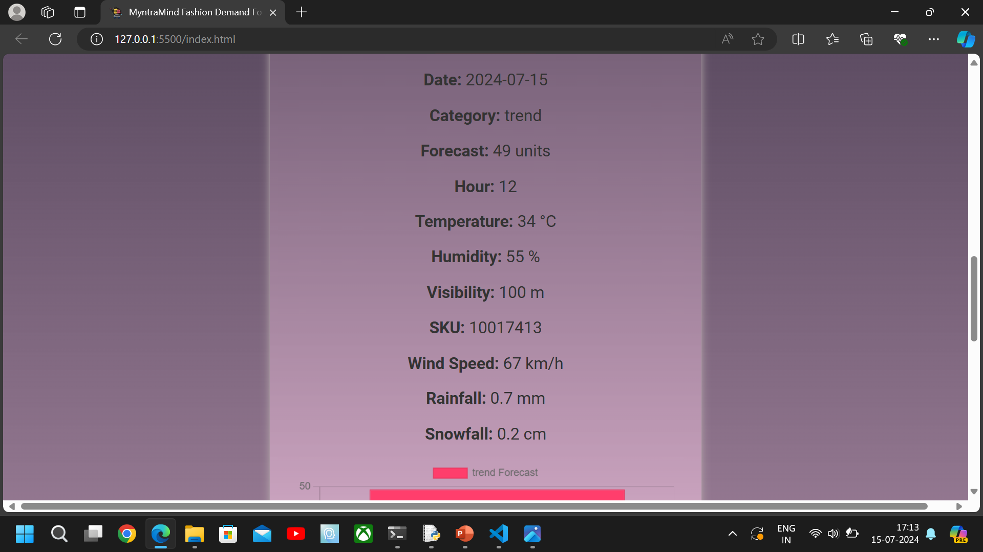
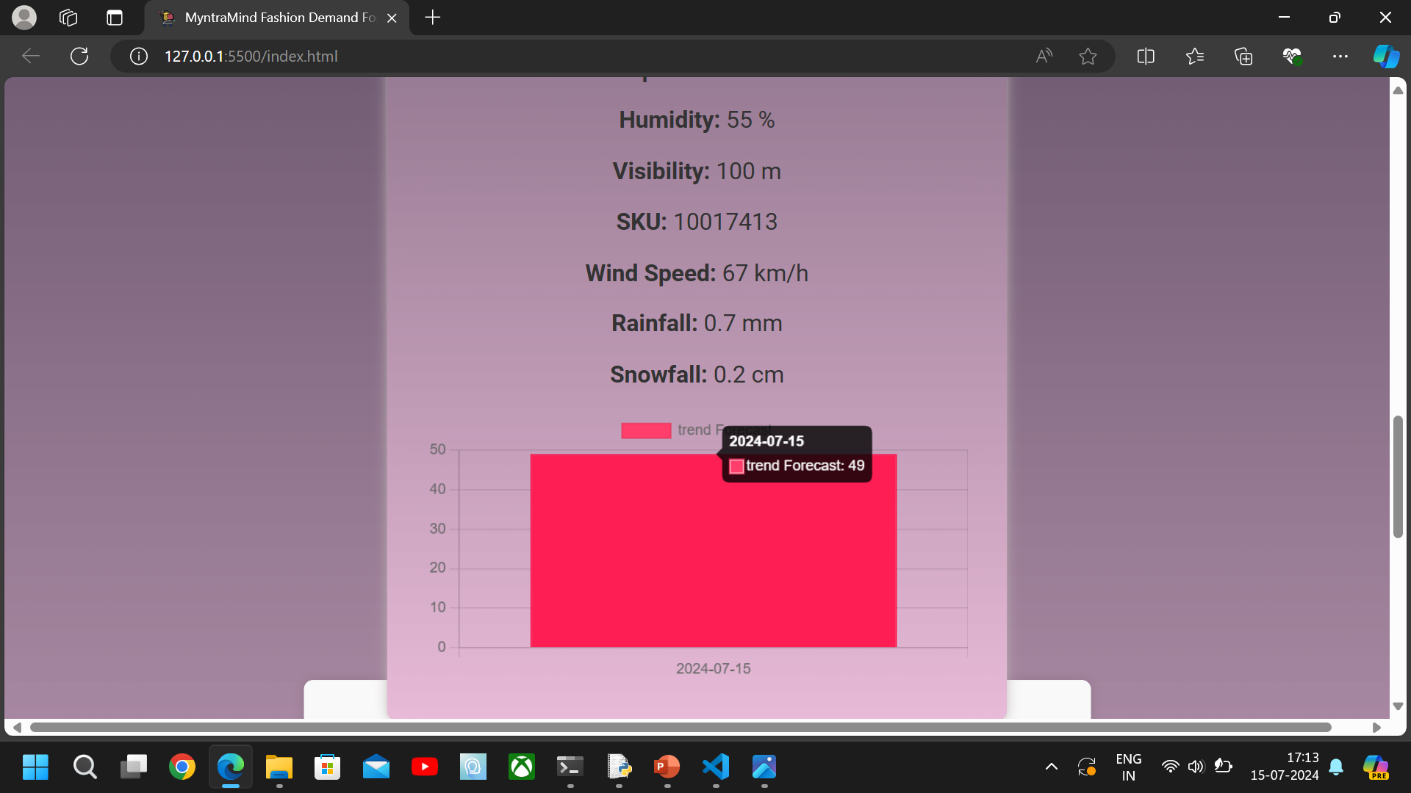
Result-Snapshots

Slide 6
Conclusions
Accuracy and Efficiency: ML-based forecasting improves accuracy, optimizing operations and financial outcomes.
Adaptability: Enables quick response to external factors, enhancing competitiveness.
Risk Management: Mitigates risks by anticipating and planning for demand fluctuations.
Strategic Advantage: Empowers proactive planning and sustainable growth strategies

